Slide 1
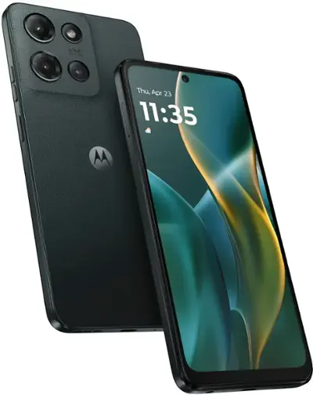
A cell phone story
chapter 1: Moto g 2025
FOUND!

Slide 2
A cell phone story
chapter 2: Samsung Galaxy 23
Nuclear Physics
Astronomy
Astrophysics

Slide 3
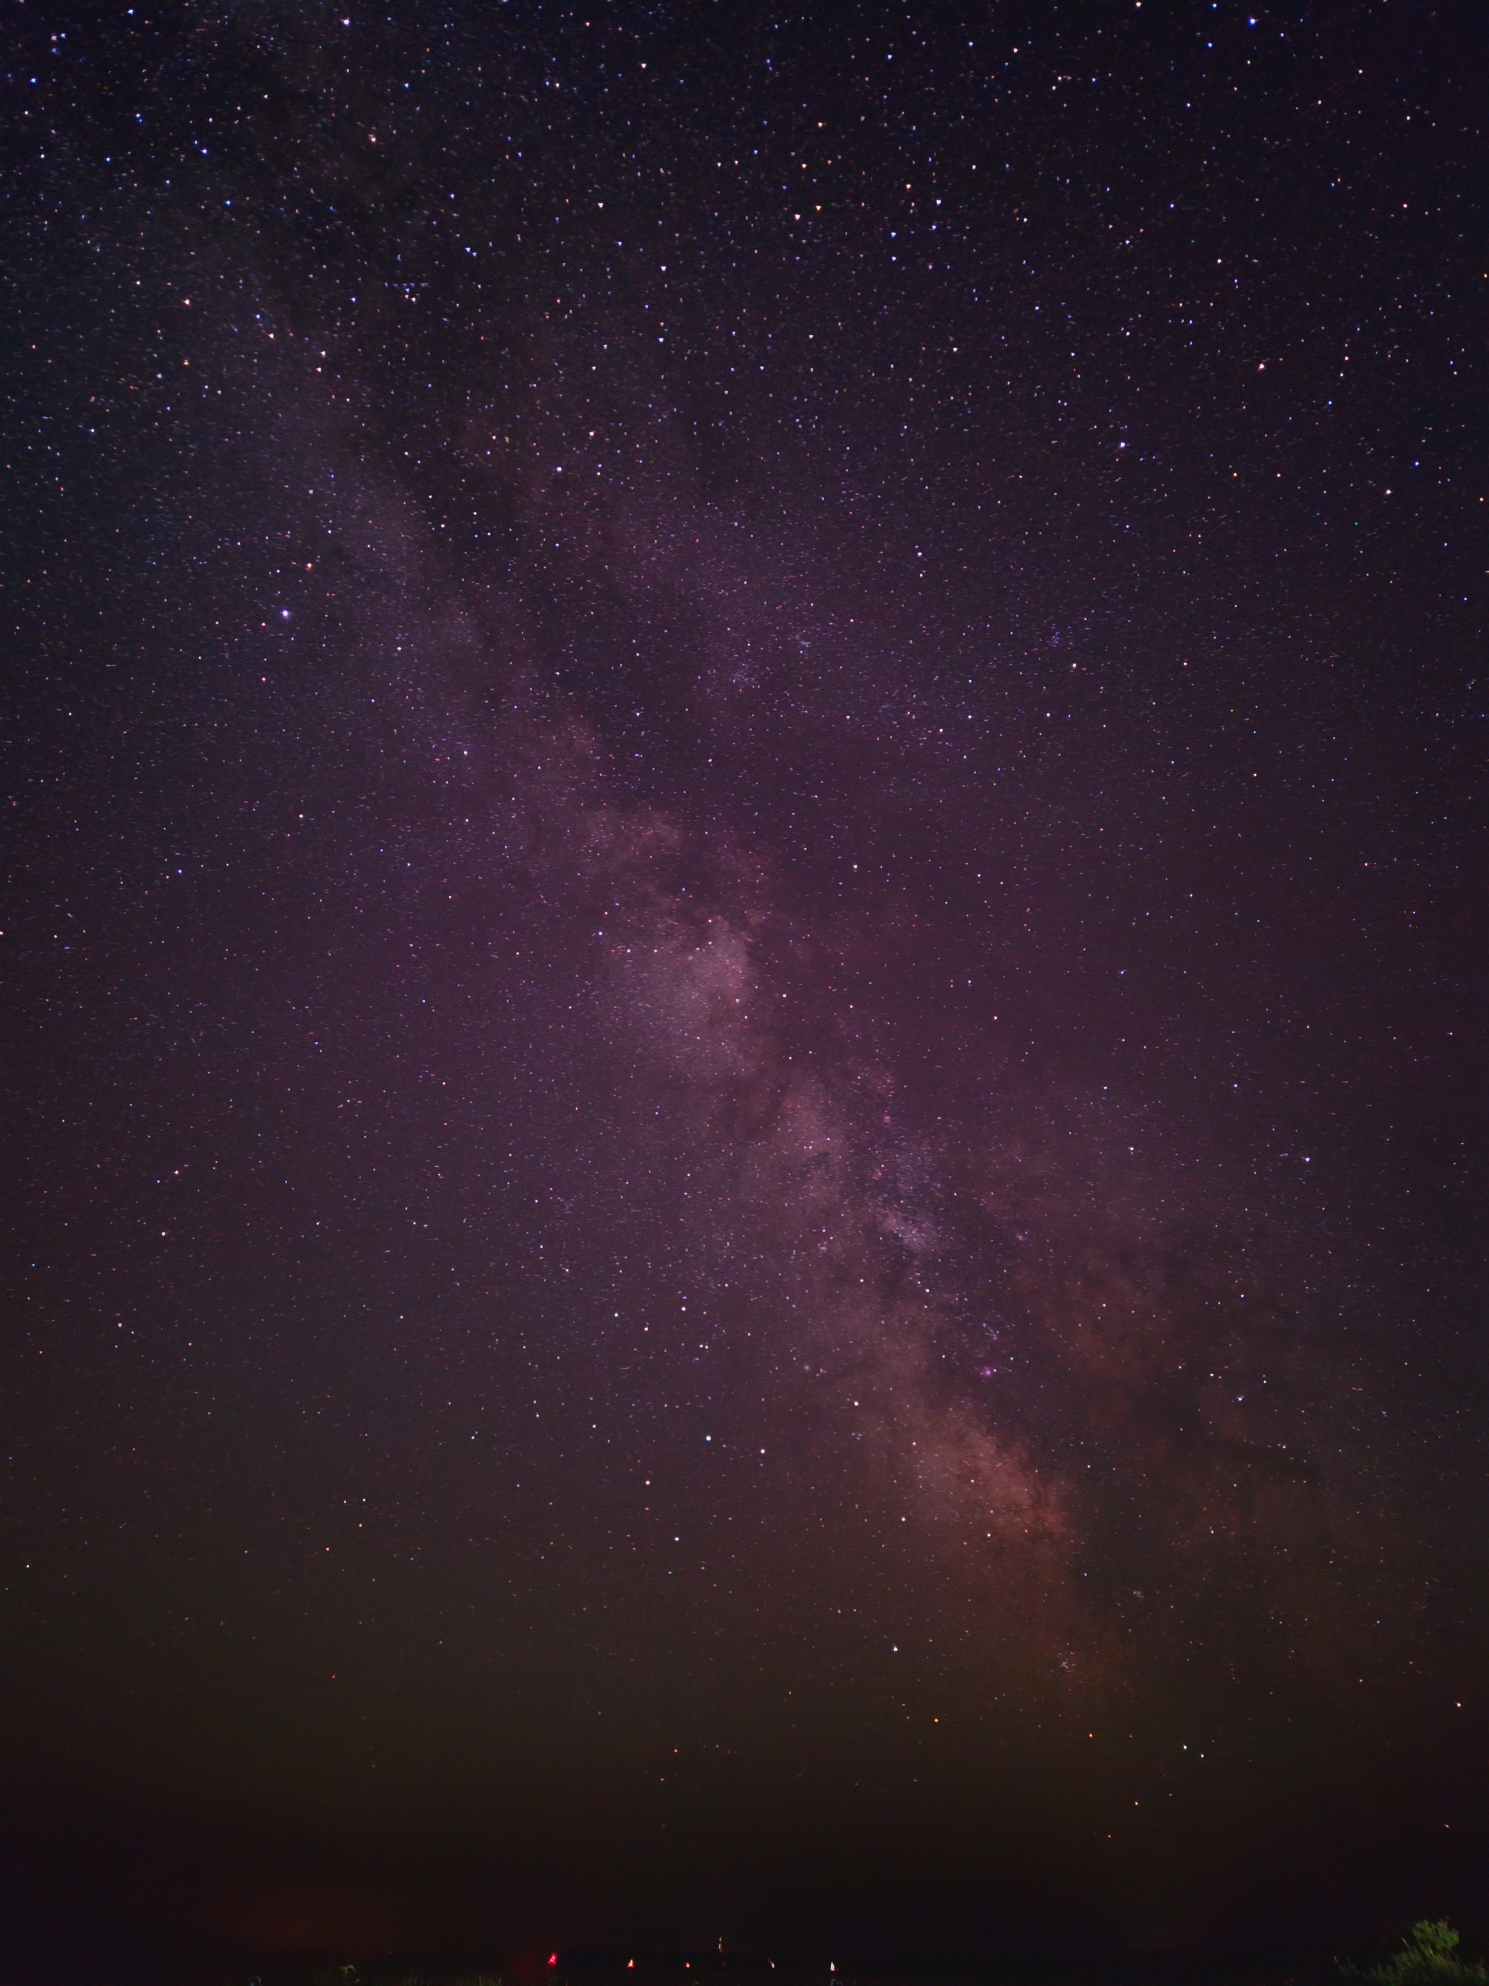
J. Gomez, S. Byrne, Ch. Gpt, T. Psaltis, I. Sultana, arXiv:123.4567 (2025)
A cell phone story
chapter 2: Samsung Galaxy 23
Nuclear Physics
Astronomy
Astrophysics

Slide 4
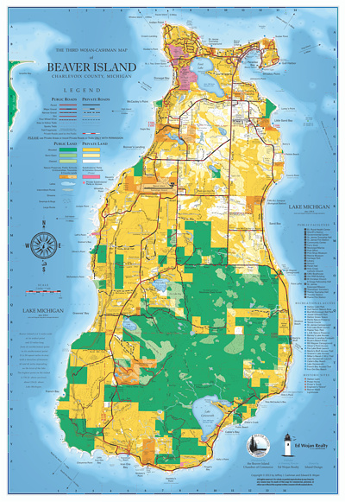
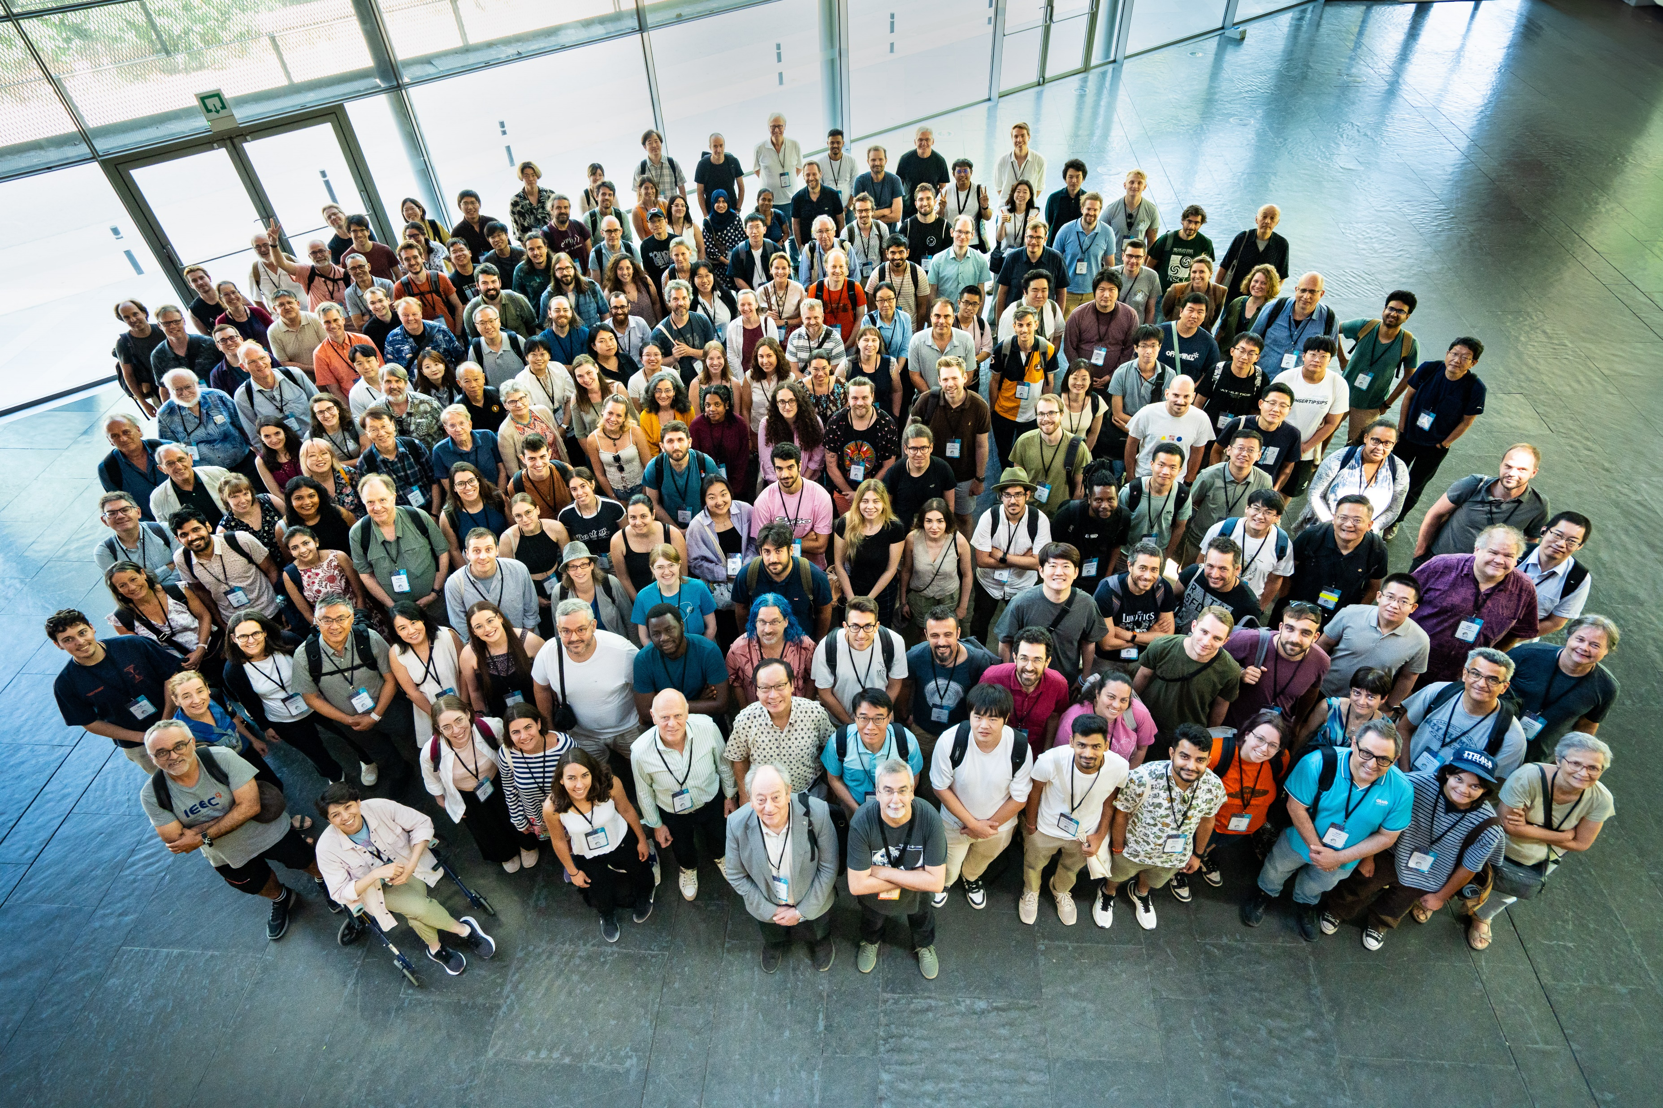
A cell phone story
chapter 3: iPhone something
Group photo!

Slide 5
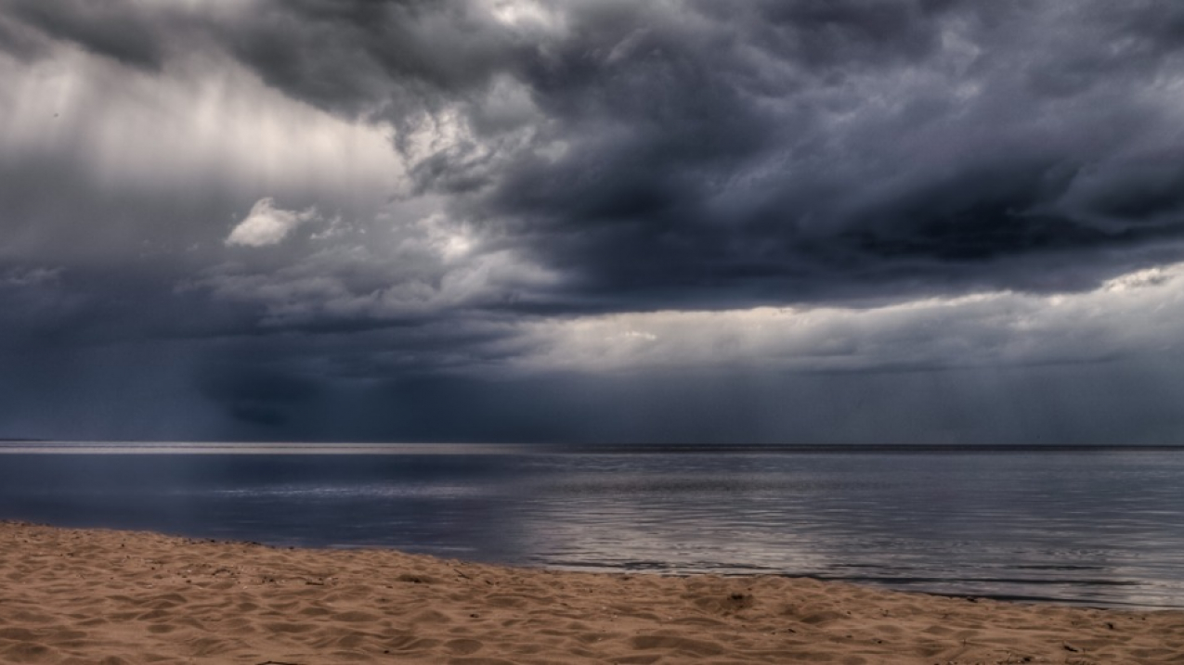
A cell phone story
chapter 3: iPhone something

Slide 6
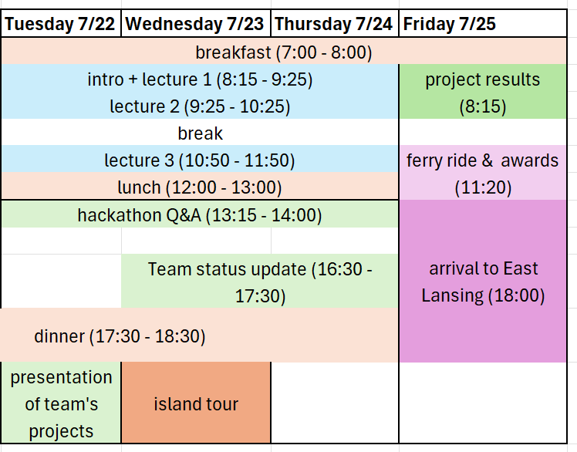
Schedule … version 1X
mentorship lunch
?

Slide 7
Schedule … version 1X
mentorship lunch
TOUR
(13:15 to 15:15)
hackathon Q&A
(16:00)

Slide 8
Beaver Island Tour
Vans will wait for us at 1pm next to main building
Coffee: Paradise Bay Coffee Shop
Light House: group photo?
Nature: blueberries and snakes
Hackathon Q&A
Before dinner (4:00 pm)

